Slide 1
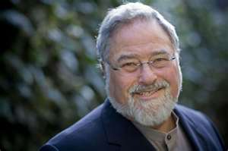
LAKOFF,
METAPHOR
AND CHALLENGES TO SYMBOLIC LOGIC MODELS OF SEMANTICS

Slide 2
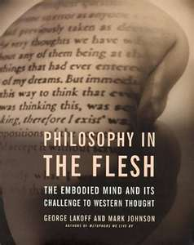
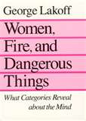

GROUND RULES
I am not defending it is true per se
Only saying using methods all create valid exceptions
References to work in notes

Slide 3
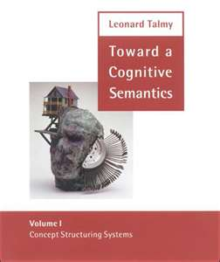
COGNITIVE SEMANTICS
Grammar is conceptualization
Conceptual Structure is embodied
Ability to use language draws upon general cognitive resources, not special language module (will leave this for now)
Notes:
Lakoff –Women, Fire and Dangerous Things

Slide 4
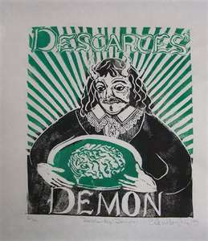
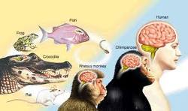
EMBODIED MIND VS. MIND/BODY SEPARATION
Really Philosophic Position
Anti-Mind-Body Dualism
Evolutionary Basis

Slide 5
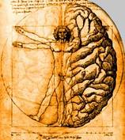
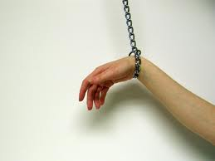
WHAT DOES EMBODIED MEAN?
Not totally objective (cultural)
Not totally subjective (body limits)
Subjective within limits bounded by physical body

Slide 6
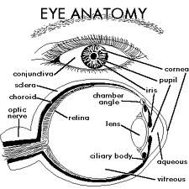
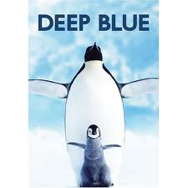
THE ALL TOO OFTEN USED EXAMPLE
Color is subject to cultural definition
Color is bound to limits due to our physical nature
Some colors are better examples than others
Notes:
Shermer-The Mind of the market:etc. Rosch for good work on color.
http://books.google.com/books?id=PKjfEOGNZWAC&printsec=frontcover&dq=compassionate+apes&source=bl&ots=uLSP0sKp57&sig=Xrvhi7jS_YhDet64e16r1GiDII8&hl=en&ei=D8r3TLxFi6CxA6qc4MgC&sa=X&oi=book_result&ct=result&resnum=4&ved=0CC8Q6AEwAw#v=snippet&q=drink&f=false

Slide 7
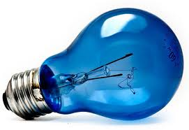
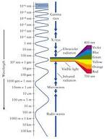
ISN’T COLOR OBJECTIVE?
Color as reflection of wavelengths?
We will see a color blue when an object reflects at 475nm but…
Just because we see blue doesn’t mean it is 475nm
Sky is not reflection of blue but refraction of blue (blue light bulb analogy)
Additive color (e.g. the color blue you see now)

Slide 8
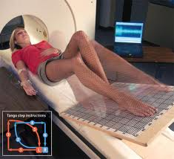
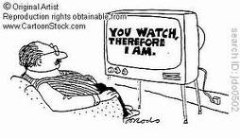
EMPIRICAL BASIS AND THEORY
Based on experiments in Cognitive Science
Not armchair or a priori notions

Slide 9
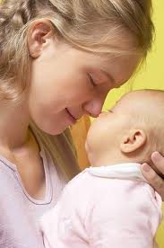
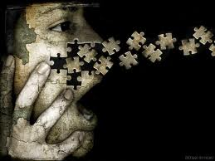
JOHNSON’S CONFLATION THEORY
Different concepts stored together when young
Warmth=Affection as child
We later separate these but they stick with us
A “warm” smile or a “close” friend
Notes:
Lakoff 607 (Kindle Edition)

Slide 10
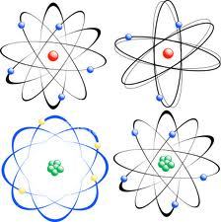
GRADY’S THEORY OF PRIMARY METAPHOR (COMPLEX METAPHOR)
All complex metaphors are “molecular” made up of “atomic” metaphor parts called “primary metaphors”
These arise without conscious thought due to cross domain associations that are formed naturally
Notes:
Lakoff 613

Slide 11
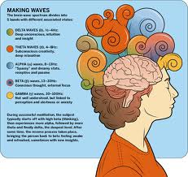
NARAYANS NEURAL THEORY OF METAPHOR
These associations are realized in the brain
The associations have a physical presence
Thus they are “embodied” concepts
Notes:
Lakoff 617

Slide 12
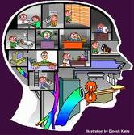
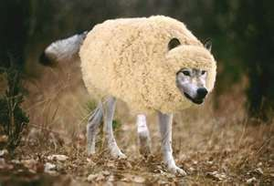
LAKOFF-WE ONLY USE METAPHOR TO REASON
Humans evolved to use metaphor
Metaphor is natural and unconscious

Slide 13

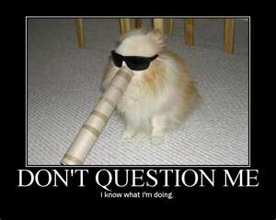
CRITICISM
Pinker-We obviously can use abstractions that are not metaphors
But do we really?

Slide 14
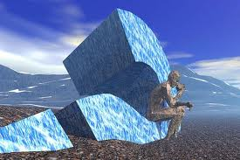
2 TESTS-WATSON SELECTION TEST
Test one (Abstract Reasoning)
If there is a vowel on one side, there must be an even number on the other side.
Which two cards must be turned over to determine if the rule is true?
M 4 E 7
Notes:
Shermer-The Mind of the market:etc.
http://books.google.com/books?id=PKjfEOGNZWAC&printsec=frontcover&dq=compassionate+apes&source=bl&ots=uLSP0sKp57&sig=Xrvhi7jS_YhDet64e16r1GiDII8&hl=en&ei=D8r3TLxFi6CxA6qc4MgC&sa=X&oi=book_result&ct=result&resnum=4&ved=0CC8Q6AEwAw#v=snippet&q=drink&f=false

Slide 15
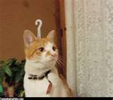

RESULT ONE
Most people get check other side of M but also decide to flip over the 4 card.
Real answer is 7 card. 20% get this correct.
Notes:
Shermer-The Mind of the market:etc.
http://books.google.com/books?id=PKjfEOGNZWAC&printsec=frontcover&dq=compassionate+apes&source=bl&ots=uLSP0sKp57&sig=Xrvhi7jS_YhDet64e16r1GiDII8&hl=en&ei=D8r3TLxFi6CxA6qc4MgC&sa=X&oi=book_result&ct=result&resnum=4&ved=0CC8Q6AEwAw#v=snippet&q=drink&f=false

Slide 16
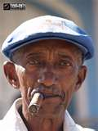


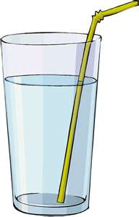
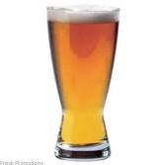
TEST 2
Nightclub with a minimum legal drinking age of twenty-one. You are the bouncer.
4 patrons at the bar.
Rule=People under 21 cannot be served alcohol. Can ask people their age or check their drink but can’t do both.
Drink/Age: 1>Water 2>Over 21 3>Beer 4>Under 21
Notes:
Shermer-The Mind of the market:etc.
http://books.google.com/books?id=PKjfEOGNZWAC&printsec=frontcover&dq=compassionate+apes&source=bl&ots=uLSP0sKp57&sig=Xrvhi7jS_YhDet64e16r1GiDII8&hl=en&ei=D8r3TLxFi6CxA6qc4MgC&sa=X&oi=book_result&ct=result&resnum=4&ved=0CC8Q6AEwAw#v=snippet&q=drink&f=false

Slide 17
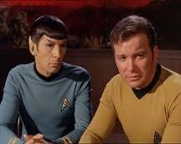
ALMOST EVERYONE SOLVES THIS PROBLEM.
Note-there are the same exact logic
We have evolved to quickly understand problem 2, problem 1 is learned (or not learned by 80%)
Second problem better example of real time language use

Slide 18
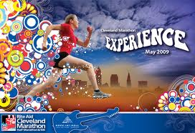
LAKOFF AND WHAT COMPUTERS LACK
Motivation
Humans make logical connections based on metaphors
These metaphors cannot be predicted
Some metaphors are more likely than others
Related to Domain of Experience

Slide 19
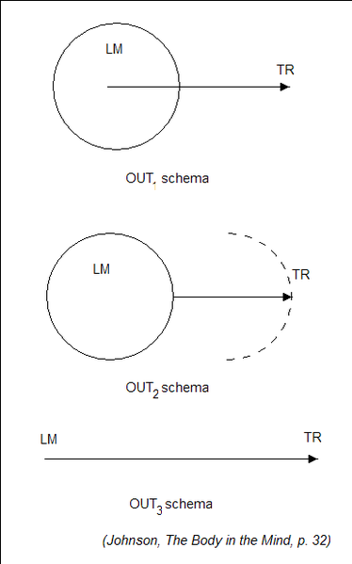

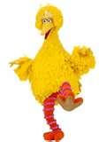
HUMANS METAPHORS
Conceptual Metaphor-reasoning with metaphor
Important is Big (big decision, small stakes)
Argument is War(win argument,shot down arguments)

Slide 20
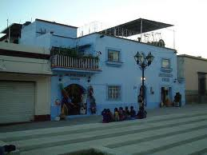

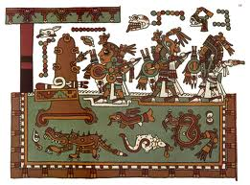
METAPHORS ARE NOT CONSISTENT BETWEEN CULTURES
Mixtec
House as animal metaphor
Back of house is Top from our metaphor
He is tanning on the house’s back
Can translate truth value but not all of statement

Slide 21


HOW TO TRANSLATE
Need to match metaphors
Mental example
The rock broke the back of the house.
Depends on which language this starts with to determine how to translate it

Slide 22
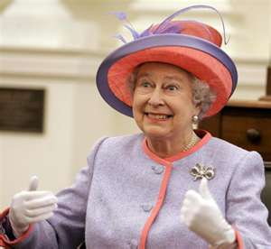


CATEGORIES DETERMINE THOUGHT
Guugu Yimithirr-Only cardinal directions
How to set up the table for queen of England?
Categories (and metaphors) help set up possible thoughts

Slide 23
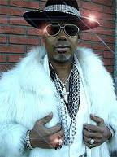
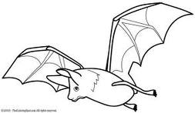
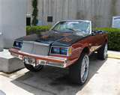
EVOLUTION IN LANGUAGE
Path dependent
In 1811- Bat was slang for prostitute
Pimp my ride
Logical but not predictable

Slide 24
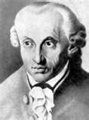
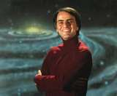
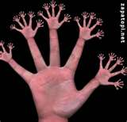
THE DEADLY METAPHOR –FRAMING PROBLEM
* What is intuitive is natural
Kant- Egocentric directions are natural
Sagan- 10 base system due to human finger count
Both really smart-both really wrong
Lakoff-important to save endangered languages
Notes:
Deutscher- Through the Looking Glass: Why the World Looks Different in Other Languages 2900
Sagan- Dragons of Eden

Slide 25
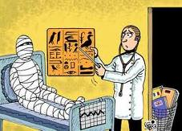
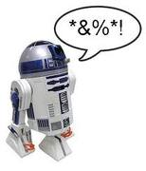
SUMMARY
Humans use unconscious metaphor and this is an empirical fact
These metaphors are motivated-logical but not predictable
Any system not capturing this fact will lead to poor description of real language

